Slide 1

Real-time RFID Cloning in the Field

Slide 2
Who am I
Dennis Maldonado (@DennisMald)
Adversarial Engineer @ LARES Consulting
Founder
Houston Locksport
Houston Area Hackers Association (HAHA)
DEFCON 23 – Hacking Access Control Systems
DEFCON 24 – Sticky Keys to the Kingdom

Slide 3
RFID
Radio Frequency Identification

Slide 4
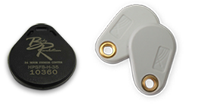
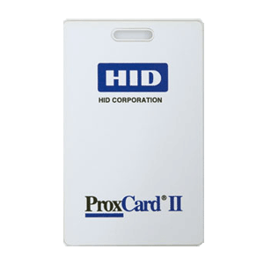
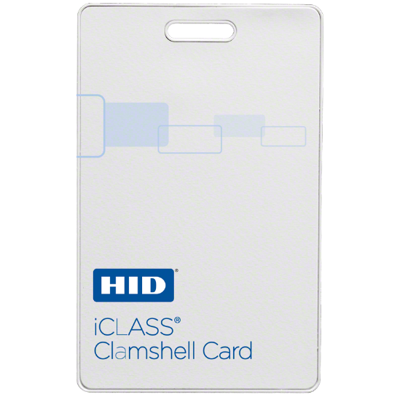

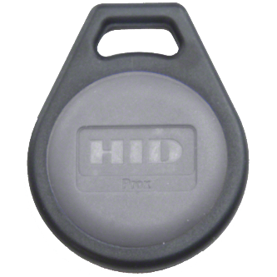
Radio Frequency Identification (RFID)
Electronic Access Control for many companies
Contactless authentication
125 kHz Low-Frequency (LF) - HID Prox, Indala, flex, ioProx, etc.
13.56 MHz High-Frequency (HF) - HID iCLASS, MIFARE, LEGIC, etc.
Credentials = cards, tags, stickers, key fobs, etc.

Slide 5

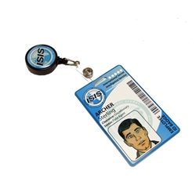

Slide 6


Slide 7
Long Range Readers

Slide 8
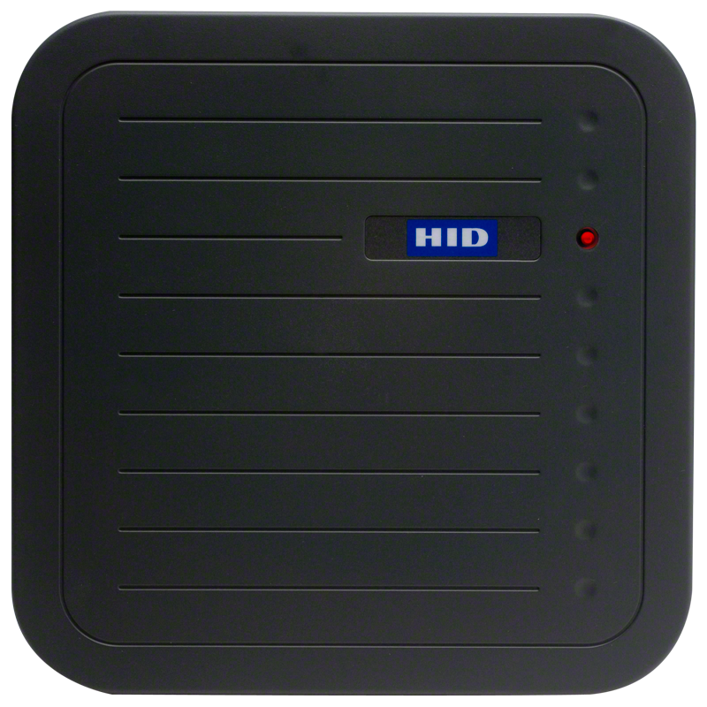
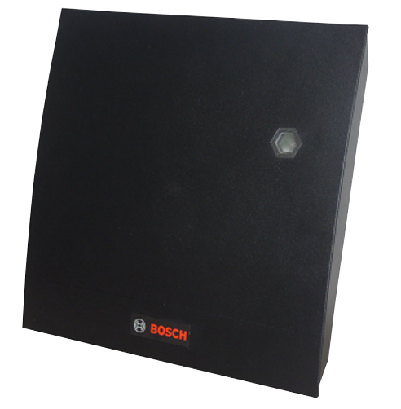
Long Range Reader
MaxiProx 5375
Reads HID Prox Cards
Read Range: 18-24 inches
R90
Reads HID iCLASS cards
Read Range 12-16 inches
Small enough to hide in a backpack
Find them on eBay

Slide 9
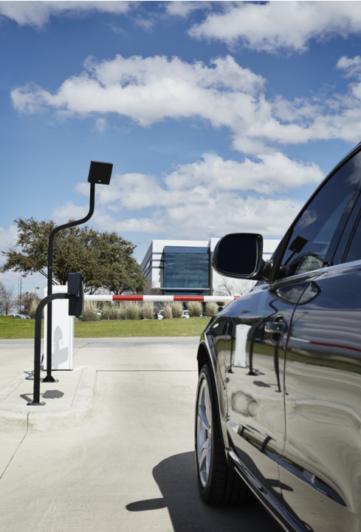
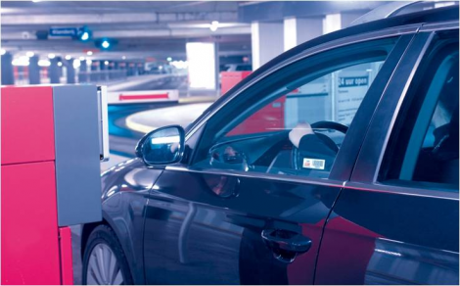

Slide 10
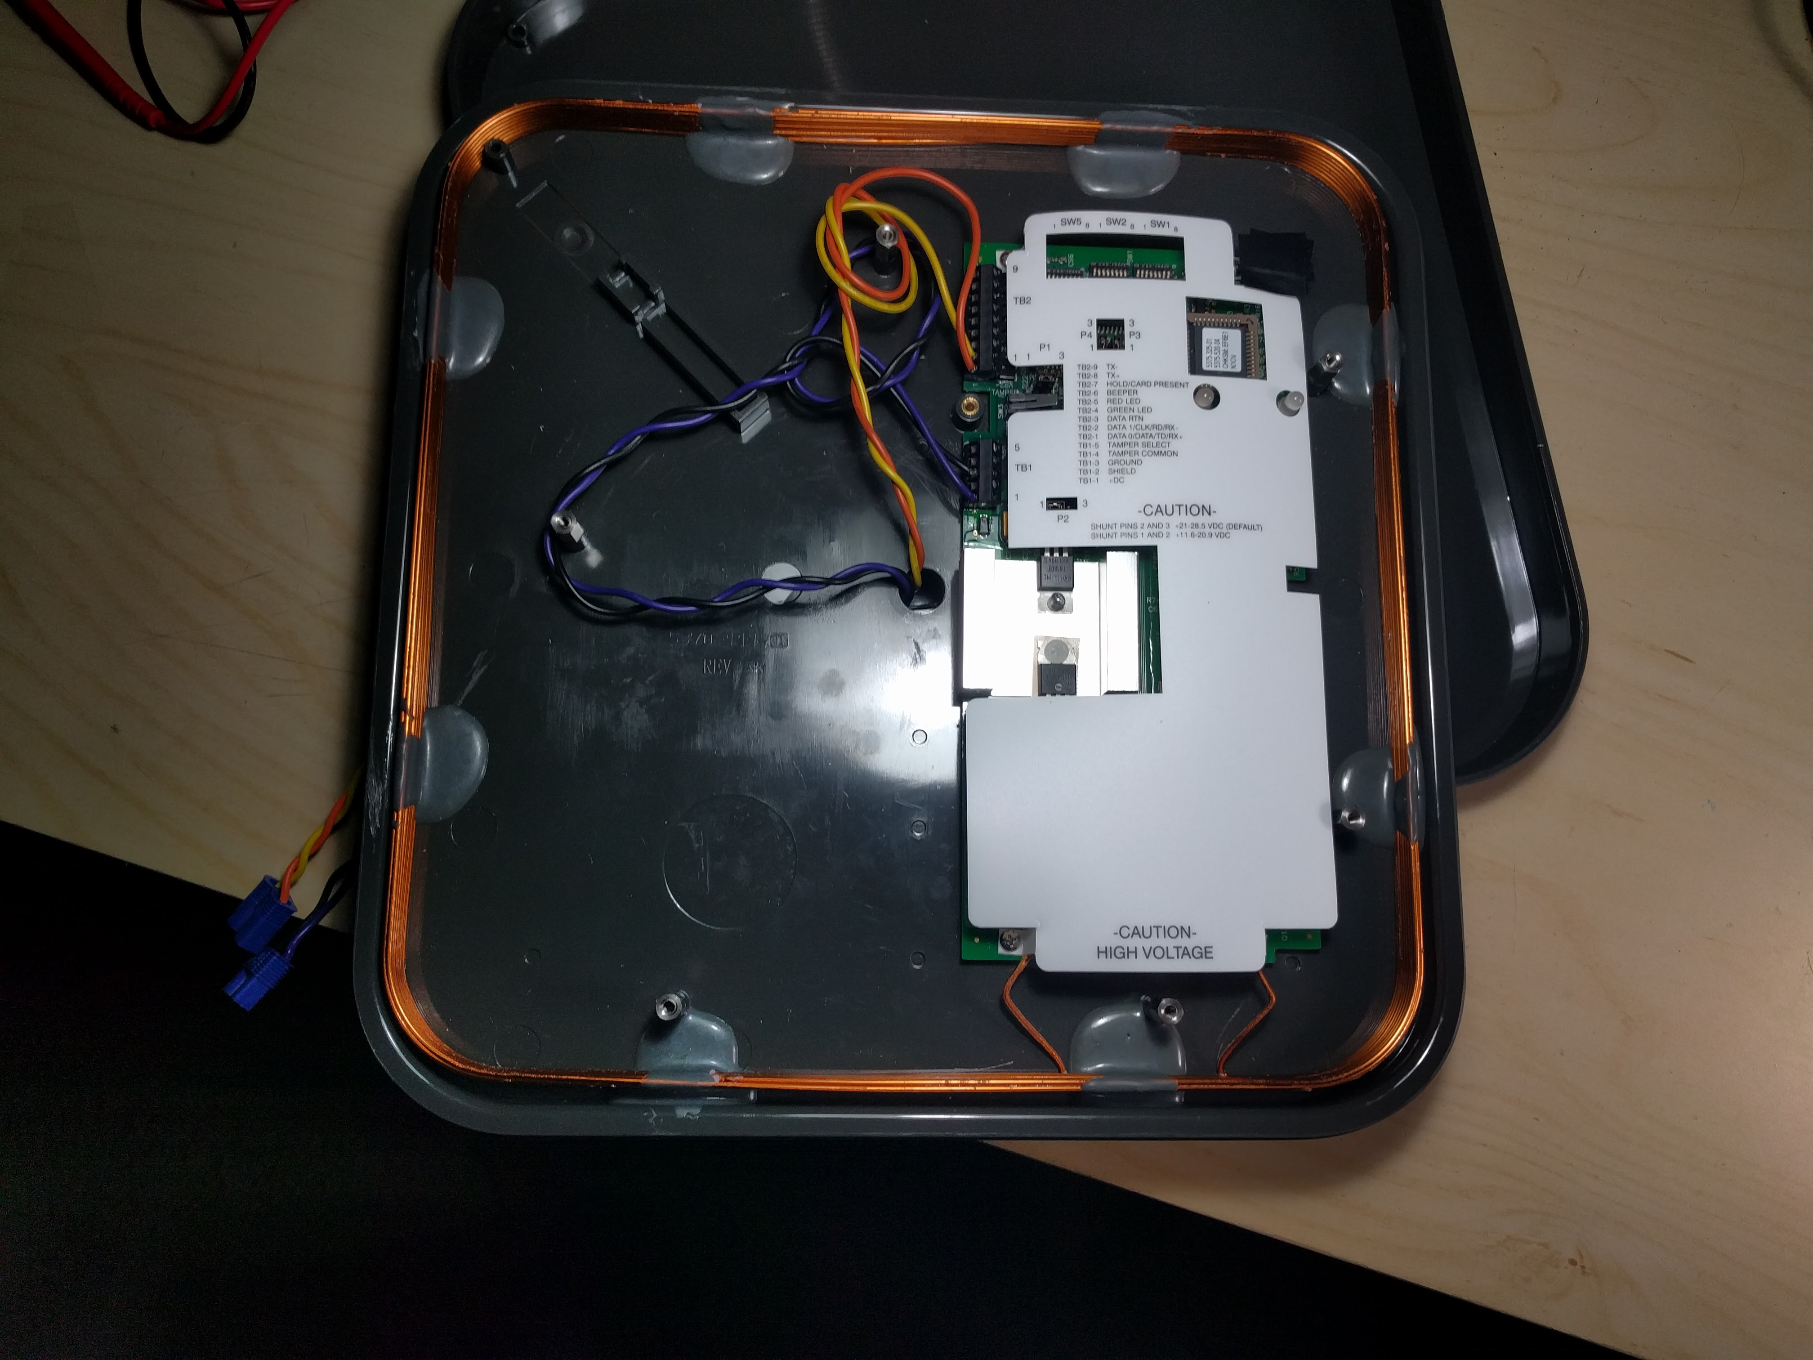

Slide 11
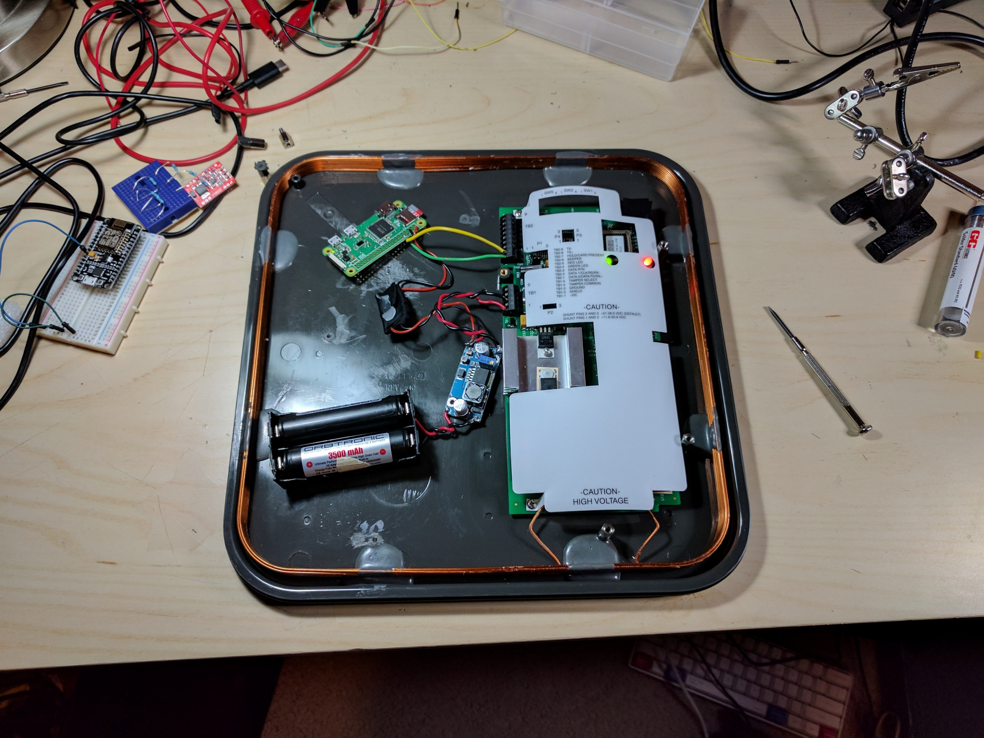
Modified Long Range Reader
Battery Source
Run the reader from batteries
Raspberry Pi Zero W
Allow for connectivity via wireless
Support for web page, android apps, etc
Communicate with other devices for automatic cloning
Automatically interpret and decode badge reads

Slide 12
Demo

Slide 13
Making your own

Slide 14
Making your own Long Range Reader
Battery Source
Supports 3 Amps
18650 Batteries
Protection circuit recommended
DC Boost Converter
Boost voltage if battery source is not at least 12v
DC Buck Converter
Step down battery voltage to 5v for the Raspberry Pi
Raspberry Pi Zero W
Wire

Slide 15
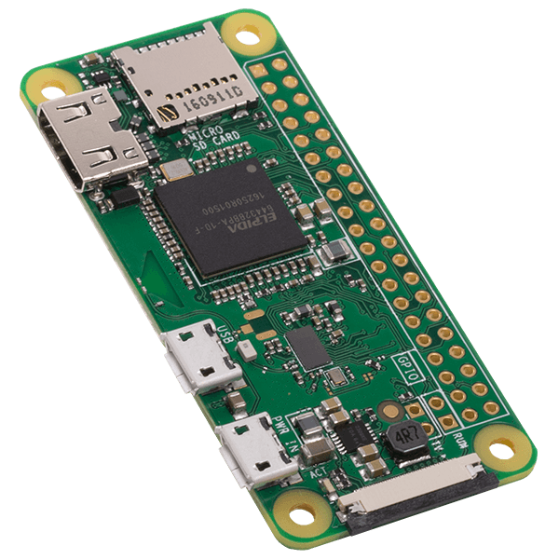
Raspberry Pi Zero W
Raspbian Jessie Lite
WI-FI Access Point
Python Code and setup script
https://github.com/linuz/LongRangeReader

Slide 16
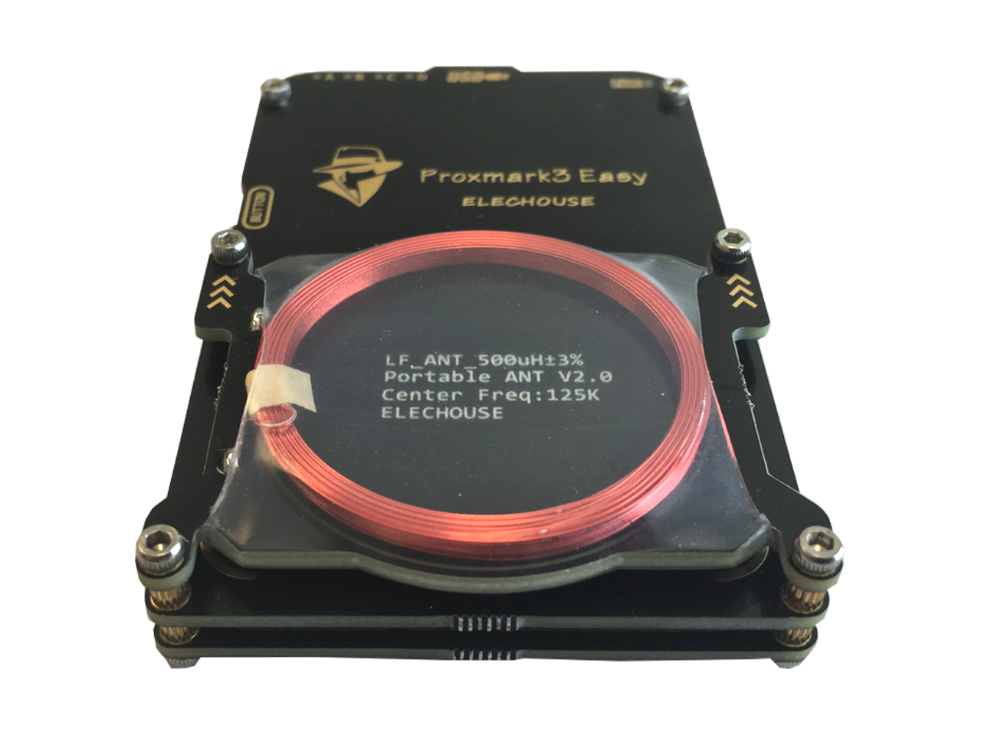
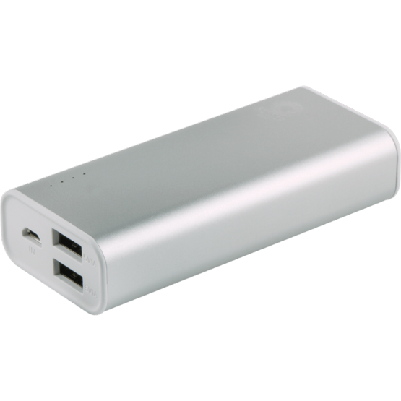
Automated Cloning
Raspberry Pi 3 or Raspberry Pi Zero W
Raspbian Jessie Lite
Proxmark3 software
USB Battery Pack
Proxmark 3

Slide 17
Questions?

